Slide 1



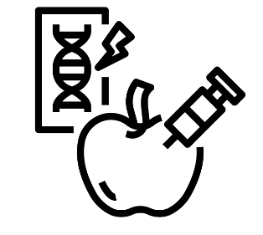
Food nutrition and health and food provenance.
Food choices linking to nutrition and provenance
Food preparation and nutrition Year 10
Half Term 6
Half Term 1
Half Term 2
Half Term 3
Half Term 4
Half Term 5
Half Term 6
Half Term 5
Food science/cooking methods linking to nutrition

Slide 2

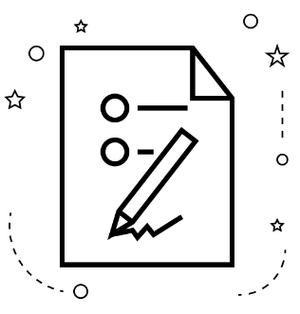

NEA 1 Food investigation and retrieval activities
Examination preparation and exam
Food preparation and nutrition Year 11
Half Term 6
Half Term 1
Half Term 2
Half Term 3
Half Term 4
Half Term 5
Half Term 6
Half Term 5
NEA 2 Food Preparation and retrieval activities

