Slide 1



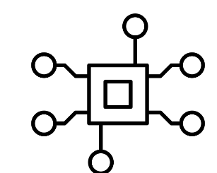
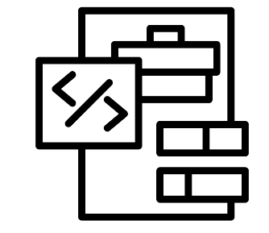

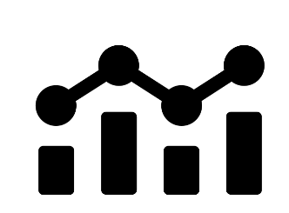
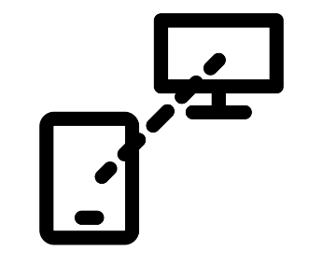
Foundations for digital success
Understanding computer systems
Introduction to text programming - Python
Computer Science Year 7
Half Term 1
Half Term 2
Half Term 3
Half Term 4
Half Term 5
Half Term 6
Block based programming - Scratch
How do computers represent our world?
Digital Product Design

Slide 2

Data representation - binary
Media – digital graphics
HTML & CSS
Computer Science Year 8
Half Term 1
Half Term 2
Half Term 3
Half Term 4
Half Term 5
Half Term 6
Computing systems
Digital safety
Python 2

Slide 3
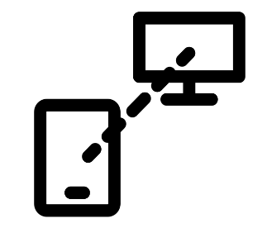
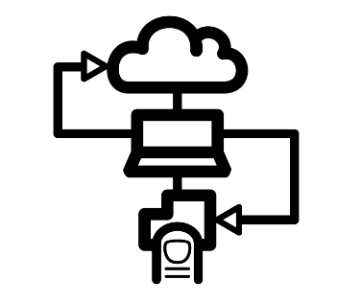
Cyber security
Data science
Programming – python
Computer Science Year 9
Half Term 1
Half Term 2
Half Term 3
Half Term 4
Half Term 5
Half Term 6
Back to the future – history of CS
Networks
Computer Science related issues

Slide 4

Data representation
Computer networks, connections and protocols
Impacts of digital technology
Computer Science Year 10
Half Term 6
Half Term 1
Half Term 2
Half Term 3
Half Term 4
Half Term 5
Half Term 6
Half Term 5
Systems architecture
Software
Algorithms

Slide 5


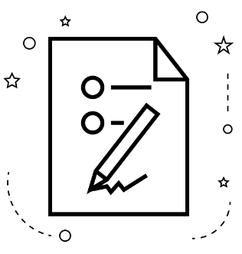
Development
Data, systems, networks 2
Development, programming 2
Science Year 11
Half Term 6
Half Term 1
Half Term 2
Half Term 3
Half Term 4
Half Term 5
Procedural programming
Software, algorithms, digital technology 2
EXAMS

