Slide 1

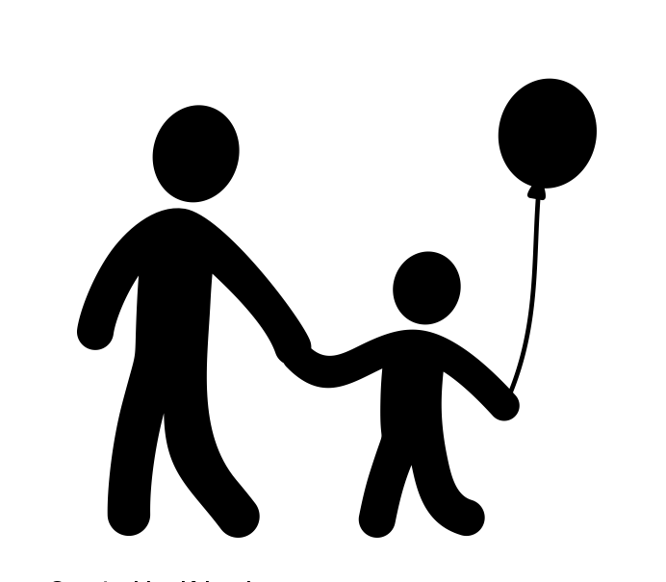


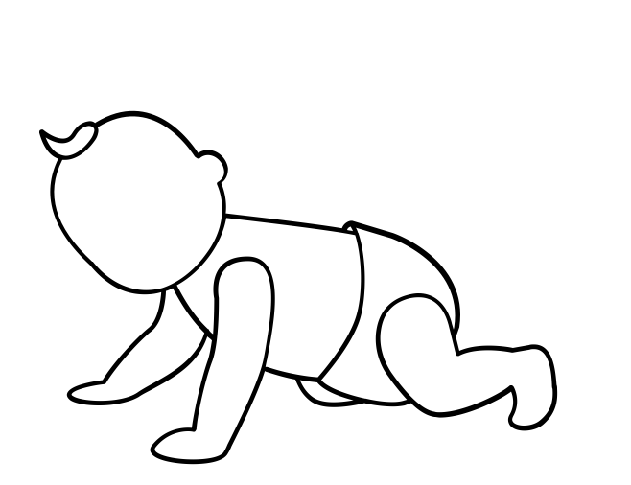
Child Development
Care routines, play and activities to support the child
YEAR 10 NCFE CACHE NCFE Child Development and Care in the Early Years
Half Term 6
Half Term 1
Half Term 2
Half Term 3
Half Term 4
Half Term 5
Half Term 6
Half Term 5
Factors that influence the child’s development
Early years provision

Slide 2





Legislation, policies and procedures in the early years
Roles and responsibilities within early years settings
Planning in Early Years Childcare
YEAR 11 NCFE CACHE NCFE Child Development and Care in the Early Years
Half Term 6
Half Term 1
Half Term 2
Half Term 3
Half Term 4
Half Term 5
Half Term 6
Half Term 5
Expectations of the early years practitioner
The importance of observations in early years childcare

