Slide 1
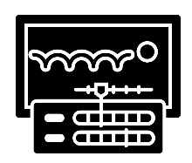
Visual identity and digital graphics
Animation with audio
Digital Games
Btec i-media Year 10
Half Term 1
Half Term 2
Half Term 3
Half Term 4
Half Term 5
Half Term 6
Creative i-media in the media industry
Creative i-media in the media industry

Slide 2
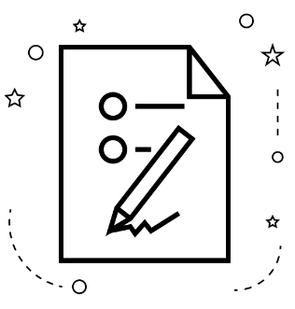
Digital Games
Exams
Btec i-media Year 11
Half Term 1
Half Term 2
Half Term 3
Half Term 4
Half Term 5
Half Term 6
Creative i-media in the media industry

