Slide 1
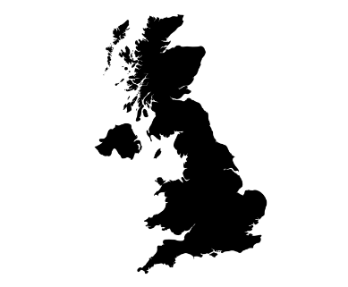
Why is the UK unique?
How is weather and climate changing?
Will we run out of resources?
Geography Year 7
Half Term 1
Half Term 2
Half Term 3
Half Term 4
Half Term 5
Half Term 6
How is our world interconnected?
Why do populations vary?
How does a river change from source to mouth?

Slide 2
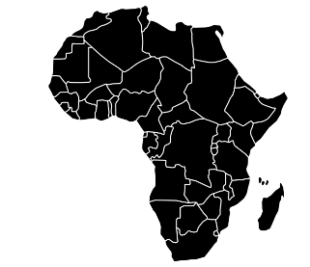
How is globalisation affecting development?
Does living in a city improve quality of life?
Are deserts all the same?
Geography Year 8
Half Term 1
Half Term 2
Half Term 3
Half Term 4
Half Term 5
Half Term 6
How do volcanoes shape our world?
Why is Africa a continent of contrasts?
How do we manage our disappearing coasts?

Slide 3
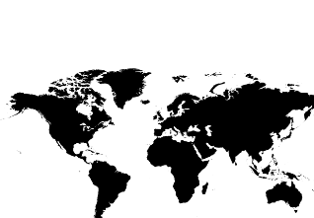
Are countries a prisoner of their geography?
What are the threats to our oceans?
Are we wrong about the world?
Geography Year 9
Half Term 1
Half Term 2
Half Term 3
Half Term 4
Half Term 5
Half Term 6
Is an equal world possible?
* 2022/23 only
Why is Africa a continent of contrasts?
Is geography important today?

Slide 4
Tectonic and weather hazards
Urban issues
Rivers and coasts
Geography Year 10
Half Term 6
Half Term 1
Half Term 2
Half Term 3
Half Term 4
Half Term 5
Half Term 6
Half Term 5
UK weather, climate change
Sustainable cities
Resource management

Slide 5
Economic inequality
LIDC
NEE
Deserts
Paper 3 pre-release
Geography Year 11
Half Term 6
Half Term 1
Half Term 2
Half Term 3
Half Term 4
Half Term 5
Tropical rainforests
UK economy
EXAMS

