Slide 1
GCSE OPTIONS 2021
The purpose of this meeting is to outline the options process at Sandymoor.
We will cover:
An outline of the process and timelines.
What to expect and how we will support you with these choices.
Who to contact regarding options
Mrs D Johnson- Vice Principal
Johnsond@sandymooroa.co.uk
Mrs L Gault- Curriculum and Assessment Assistant
gaultl@sandymooroa.co.uk
Please can you ensure your video is off.
If as we go through you have any questions please type them in the chat.
If we don’t answer immediately we will contact you with the answers, or produce an FAQ document and send out on parentmail.

Slide 2
The goal of the options process is:
To find out the subjects that most interest you so we can offer the most
popular courses.
2. To ensure that as many students as possible are able to study the combination of courses that they want to and are required to study for their future careers.
We are as flexible as possible and we will ensure we talk to you throughout.
Complex process and it is impossible to achieve 100% of students getting exactly what they want.
Students choose 2 subjects for each block and we need students to be prepared to study either of these subjects.
It is possible to identify your first choice and reserve choice. But please ensure you are prepared to study any of your reserve choices if necessary.
In order to achieve this goal we are approaching this process in 2 stages:
STAGE 1: EXPRESSION OF INTEREST
STAGE 2: FINAL OPTIONS

Slide 3
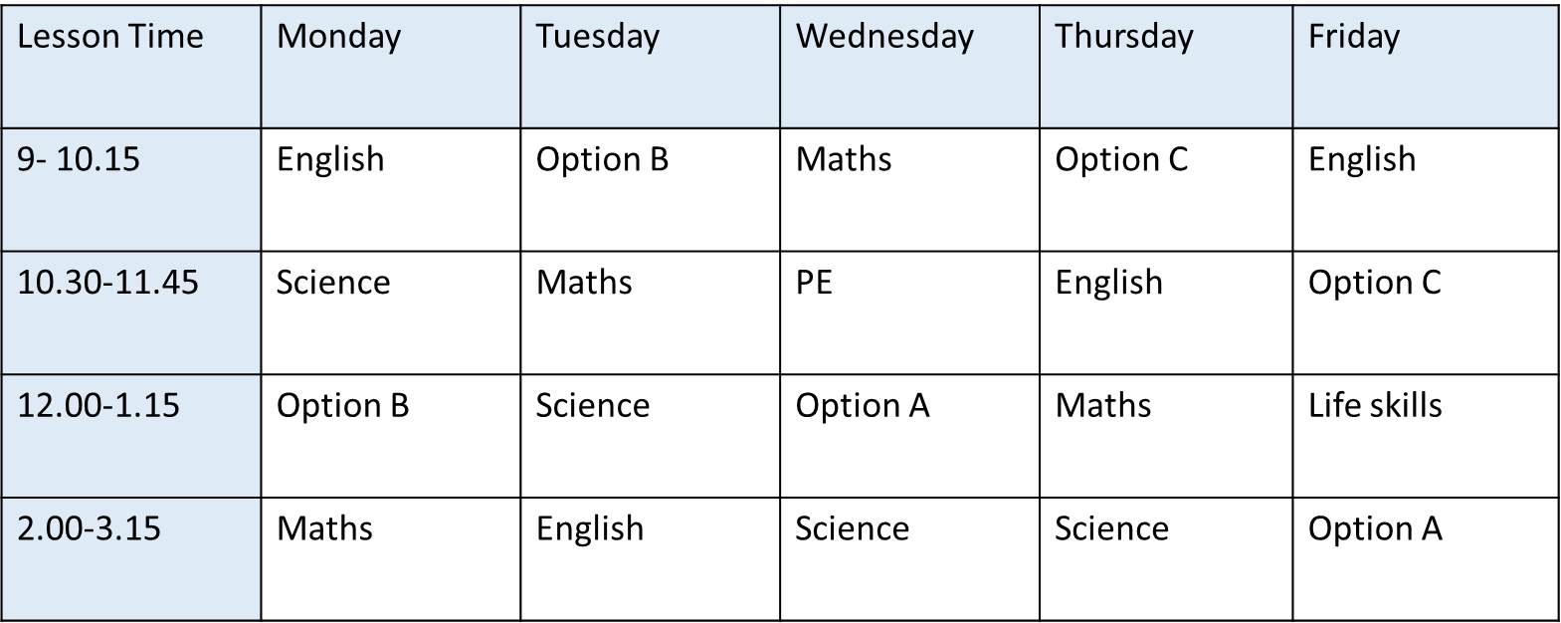
When students choose their options they are choosing what to do with some blocks of time.
Each option block is actually 3 hours in a normal school timetable.
Obviously students can’t be in 2 places at once which is why they cant study 2 subjects in one option block!
Students have all chosen subjects that occupy this block of time
Different subjects must occupy these time slots so that students can study the combination of subjects they want to.

Slide 4
Option A | Option B | Option C
Geography | Business | Spanish
History | Sport | Computer science
Spanish | Art | Engineering
If we build the blocks before asking students for their preferred combinations we would restrict the choices students can make…
Therefore we ask students to tell us which subjects they are interested in, we narrow the choices down to courses that have enough interest to ensure there will be enough students in the class or enough for 2 classes of the subject.
We then use a computer program to work out what subjects should go into each block of time to ensure the highest number of students possible receive their preferred choices.

Slide 5
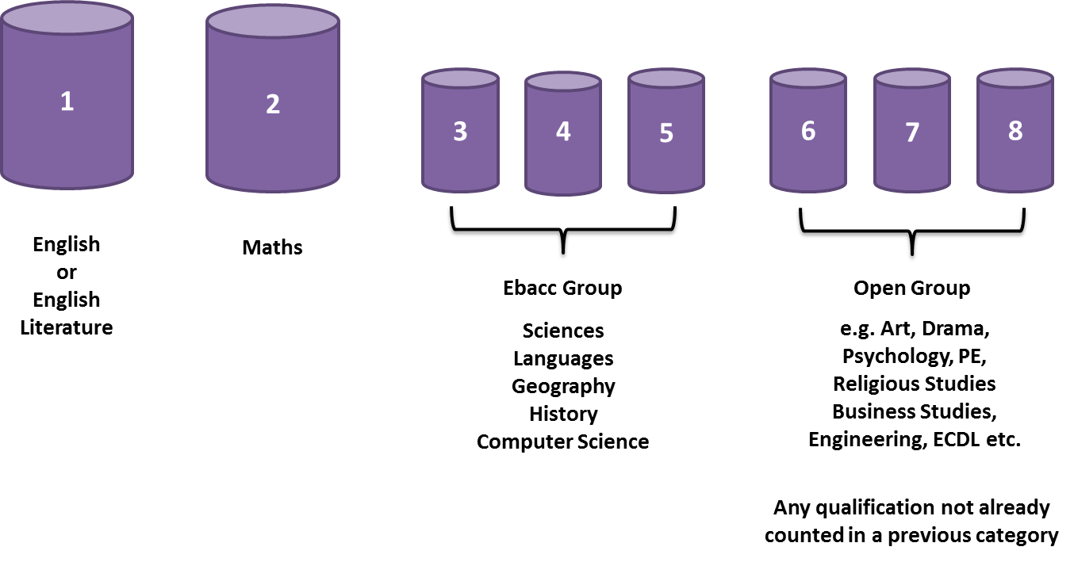
Why do students need to take GCSE options?
The government says that schools need to offer students the opportunity to achieve their best 8 grades in a certain combination of subjects. This is called Attainment 8.
These subjects are:
Some sixth form colleges use this for their entrance criteria.
There are 8 buckets that make up this score.
As the 9-1 GCSEs are very demanding and the average of these eight grades is calculated, it is more beneficial for students to study fewer GCSEs and achieve higher grades.

Slide 6
How do these buckets look at Sandymoor
Bucket 7 and 8 will be Option Blocks B and C.
There are many subjects that can occupy these 2 buckets. This is why we need you to express your interest in these subjects.
You will choose 4 and be allocated 2 of these 4 choices.
Language
Buckets 3 and 4 are filled by combined science. This covers all sciences and awards 2 GCSEs. Less content is studied and exams are shorter. This is still a very demanding course.
Bucket 5 is filled by the subject allocated in OPTION A from History, Geography or Spanish. We ask you to choose 2 of these and be happy to study either one.
If your child chooses the STEM pathway all 3 of these buckets are filled by Triple science.
Bucket 6 is filled by English Literature for all students.
* This is slightly different, if your child chooses the STEM pathway.

Slide 7
THE STEM PATHWAY
This is a fantastic opportunity we are excited to introduce this year. The student voice research from year 9 indicates there are many students who aim to be the Mathematicians, Biologists, Chemists, Computer Scientists or Physicists of the future. We are very lucky to have such a highly talented cohort for who we can offer a very academically rigorous route.
Students who choose this pathway will be studying a total of 10 GCSEs.
This is because these courses are intertwined and subject content may be covered through cross- curricular projects.
This will be a very demanding route and require students to be committed and have a mature, highly focused attitude to learning.
Language
The highest grades in the following will fill these buckets:
Computer Science
Biology
Chemistry
Physics
The highest grades in:
Statistics
Further Maths
English Literature
1 further option

Slide 8
There are literally hundreds of GCSE and BTEC courses that we as a school could run and offer for students to study!
Our subject expert teachers look at these and decide which ones are the most suitable for our students.
The information about the courses we are able to offer in 2021 can be found on the year 9 team at the end of this meeting and will also be emailed to all students.
It is not possible however to run all of these courses as there are just too many!
We can only run courses that enough students want to study.

Slide 9
Stage 1 – Expression of Interest
As with everything in the current climate, these dates are provisional and may be subject to change due to external events.
Info meeting 2nd Feb
Inform of process of expressions of interest.
Provide information about all possible subjects that could be offered at Sandymoor.
12th Feb
Complete expressions of interest form. The form is at the end of the information power-point. It has been set as an assignment on the year 9 team.
Make sure you have completed this by 12th Feb
Choose 6 subjects you are interested in studying
W.C 19TH April
Taster lessons to be attended in the lessons you have expressed an interest in (this could be virtual, but ideally we will wait and hope we are back in school)

Slide 10
Stage 2- Final Options
As with everything in the current climate, these dates are provisional and may be subject to change due to external events.
W.C 19TH April
Final option choices released
Final options meeting for parents
14th May
Deadline for final option choices to be made on “Options Online”.
28th May
Deadline for confirming option allocations back to parents and students.
This will ask you to choose 2 subjects in each category that you will be happy studying.

Slide 11
How we will support you with this decision.
Within Life skills lessons, you have been given access to a platform called UNIFROG
This will help you explore possible future careers that may interest you.
You will also have the opportunity to have a careers meeting with the local authority careers advice and guidance service.
Also during these lessons you will be focusing on the routes to higher education, A-levels, apprenticeships etc.
All of your subject teachers are available to discuss these courses with you. There are links within the subject information power-point to the exam board websites which provide full details of these courses.
Progress report with GCSE Readiness released 26th February
Parents evening 2nd March,
ALL COMMUNICATIONS WILL BE POSTED ON THE YEAR 9 TEAM AND EMAILED TO YOUR CHILD.
So it is important you ask your child to keep checking these.

